Slide 1
From Wearables to Continuous Diagnostics, Monitoring, and Evaluation (CDME)
Shahid N. Shah

Slide 2
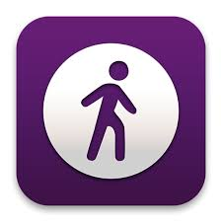
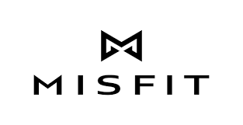
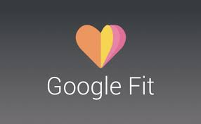
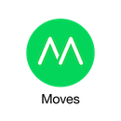
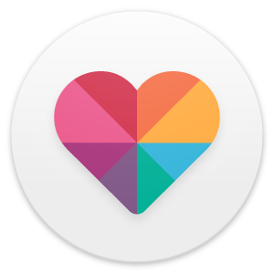
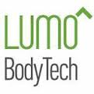
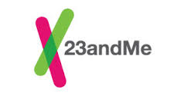
Current Generation Diagnostics
50M
50M
136K
66K
42K
5M
249K
62K
5M
47K
500K
52K
34K
56K
5M
19K
24K
500K
25K
284K
50M
80K
46K
5M
3K
30K
18K
50M
1M
97K
30K
77K
500K
6K
32K
50M
5K
2K
202K
58K
5M
15K
and growing…
Followers
Likes
Installs
Ratings

Slide 3
Next Generation Diagnostics
Omron's wrist-worn health wearable clinically accurate blood pressure monitor (BPM). The wristband also collects data like steps, calories burned, and sleep quality.
The ReSound LiNX2 is its second-gen hearing aid that enables wearers to control their hearing via an iPhone app.
RightEye goggles use eye tracking and gaming stimuli to measure vision performance which providers can use to assess eyesight and detect concussions or if someone has had a head injury within the previous six months.
GymWatch is a fitness-focused wearable, but it has a specific niche: Tracking speed and form during body weight exercises. The wearable band is strapped to the arm or leg while you lift weights, use gym machines, or do body weight exercises. It detects the range of motion and strength used during exercise, and offers real-time feedback on your form.
Hexoskin has gone beyond fitness bands to create smart clothing. Its biometric shirts have sensors woven into the fabric for measuring your heart rate, pace, breathing rate and volume, steps taken, calories burned, and sleep.
iHealth Rhythm, a smart electrocardiogram that records heart activity and saves data to an iOS app, is worn under clothing.
Veta's smart case for EpiPen holders aims to help people be prepared in the event of an emergency. The case holds an EpiPen and connects with a mobile app that can be downloaded by the patient and their family, friends, or caregivers. It comes with features like FindMe, which displays the pen's last known location; separation alerts, which trigger a notification when the case is left behind; and temperature and expiry monitors so a patient knows when their medication is too warm, cold, or old to be effective.
LumiWave provides infrared light therapy to people with chronic pain. The infrared light penetrates tissue and causes the body to release natural pain relief. Each therapy session lasts about 20 to 30 minutes, and the device is temperature controlled to protect the wearer.
Thermo, built by Withings, is a smart temporal thermometer that contains 16 sensors and HotSpot sensor technology to record accurate body temperatures.
http://www.informationweek.com/healthcare/mobile-and-wireless/10-healthcare-wearables-devices-dominating-ces/d/d-id/1323787?image_number=7

Slide 4
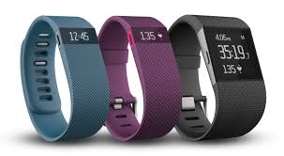
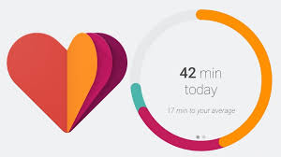
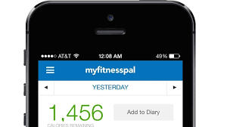
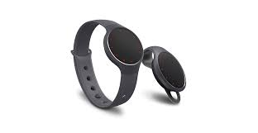
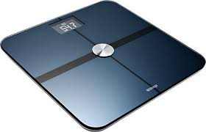
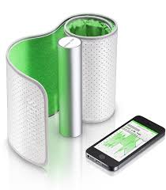
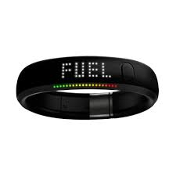
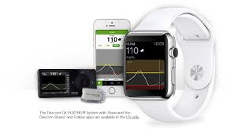
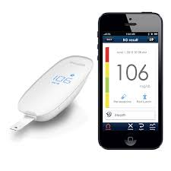
Your users are using...
To pull data, you need to…
GET /fitbit/fitness
GET /misfit/fitness
Your
App
GET /withings/weight
GET /mfp/calories
GET /gfit/glucose
Build and maintain API clients for each source to pull data, normalize, integrate and store it

Slide 5
Your users are using...
What developers need…
GET /fitbit/fitness
GET /misfit/fitness
Middleware
Your
App
GET /withings/weight
GET /health
GET /mfp/calories
GET /gfit/glucose

